Slide 1

Redis Stack

Slide 2
What is Covered
Overview of Redis Stack
Installation of Redis Stack
Redis Insight
Full Stack App (Spring Boot + Redis Stack + REST API + Next Js)

Slide 3



Reach Me
@DailyCodeBuffer
@dailycodebuffer
/in/shabbir-dawoodi/

Slide 4
What is Redis Stack?
Redis Stack is an extension of Redis that adds modern data models and processing engines to provide a complete developer experience.
Queryable JSON documents
Full-text search
Time series data (ingestion & querying)
Graph data models with the Cypher query language
Probabilistic data structures

Slide 5
Why Redis Stack?
Developer Focused to create Real -Time Applications
Sub millisecond Process time
Modern data models and data processing tools (Document, Graph, Search, and Time Series).
Several Redis client libraries support Redis Stack.
Redis Stack also includes RedisInsight, a visualization tool for understanding and optimizing Redis data.

Slide 6
Components of Redis Stack
RediSearch
RedisGraph
RedisTimeSeries
RedisBloom
Redis Insight

Slide 7
RediSearch
RediSearch provides secondary indexing, full-text search, and a query language for Redis.
These feature enable multi-field queries, aggregation, exact phrase matching, and numeric filtering for text queries.
https://redis.io/commands/?name=ft.

Slide 8
RedisJSON
Provides JSON support in Redis
RedisJSON lets your store, update, and retrieve JSON values in Redis.
Works seamlessly with RediSearch to let you index and query your JSON documents.
https://redis.io/commands/?group=json

Slide 9
RedisJSON (Primary Features)
Full support for the JSON standard
A JSONPath-like syntax for selecting elements inside documents
Documents stored as binary data in a tree structure, allowing fast access to sub-elements

Slide 10
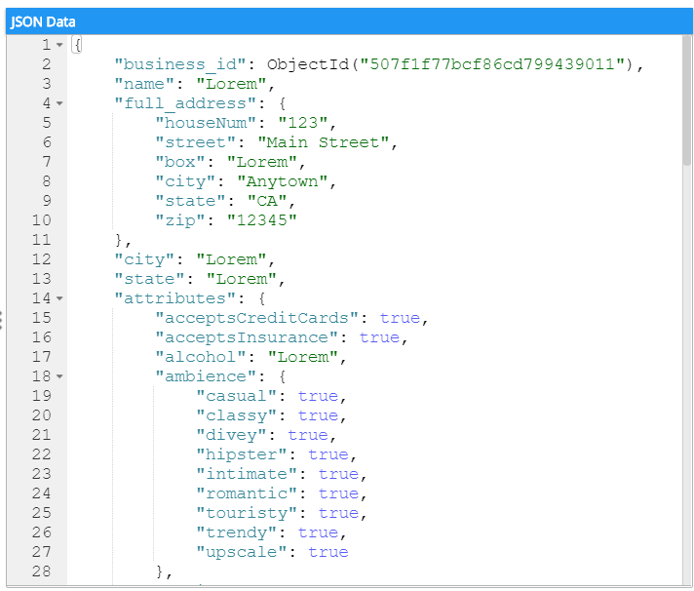

Slide 11
RedisGraph
RedisGraph is a graph database built on Redis
Graphs represented as sparse adjacency matrices
Cypher as the query language
https://redis.io/commands/?group=graph

Slide 12
F11
F21
F22
F31
F2
F12
F1
You
F3
F32
F4
F13
F41
F42
F33

Slide 13
RedisTimeSeries
It adds a time series data structure to Redis.
High volume inserts, low latency reads
Query by start time and end-time
Aggregated queries
Downsampling / compaction for automatically updated aggregate time series
Each time series has labels (field value pairs) which will allows to query by labels
https://redis.io/commands/?group=timeseries

Slide 14
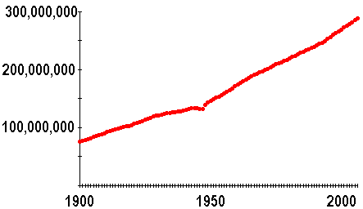
RedisTimeSeries

Slide 15
RedisBloom
Bloom filters and other probabilistic data structures for Redis
a scalable Bloom filter, a cuckoo filter, a count-min sketch, and a top-k.
Bloom and cuckoo filters are used to determine, with a high degree of certainty, whether an element is a member of a set.
A count-min sketch is generally used to determine the frequency of events in a stream.
A top-k maintains a list of k most frequently seen items.
Each time series has labels (field value pairs) which will allows to query by labels
https://redis.io/docs/stack/bloom/commands/

Slide 16
RedisInsight
A powerful tool for visualizing and optimizing data in Redis or Redis Stack
making real-time application development easier
RedisInsight lets you do both GUI- and CLI-based interactions in a fully-featured desktop GUI client.

